Slide 1
Kyphon™
Balloon Kyphoplasty Product overview
April 4, 2018
Amy Gates
  Principal Training and Education Specialist
PMD020227-1.0 | © 2017 Medtronic Inc. All Rights Reserved.

Slide 2
objectives
Understand the array of instrumentation available for the Kyphon™ Balloon Kyphoplasty Procedure

Slide 3
Instrumentation design
Allows ease of preparation and use
Instruments have consistent markings
  Give the physician the option of reducing number of images taken
  Allow the Medtronic Representative to differentiate items easily
Instruments are color coded
  Access instrument handles indicate tip shape
  Balloon bands indicate length and diameter

Slide 4
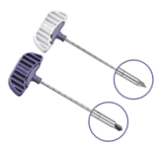

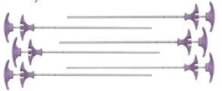



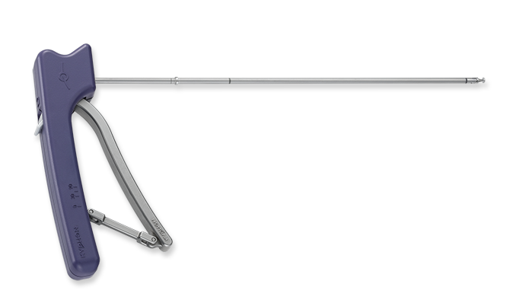
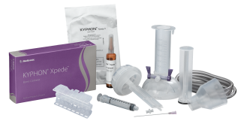
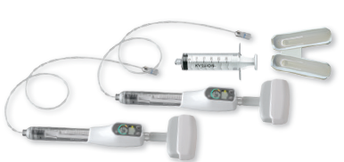
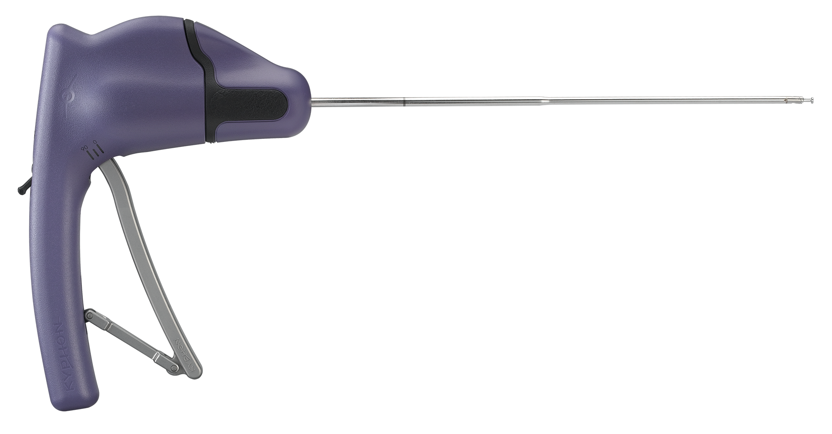
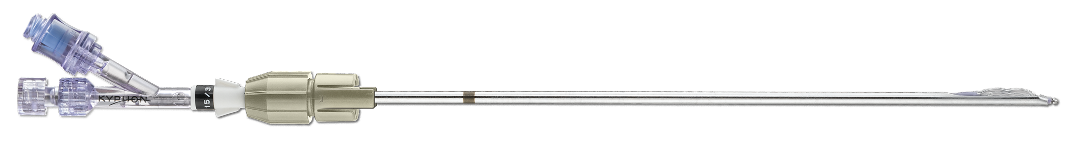
Product Flow Chart
Access
Biopsy (optional)
Drill
Cavity Creation/ Fracture Reduction
Inject
Products shown are representative and do not include all products available.
Notes:
Summary of topics covered in this presentation

Slide 5
Access

Slide 6
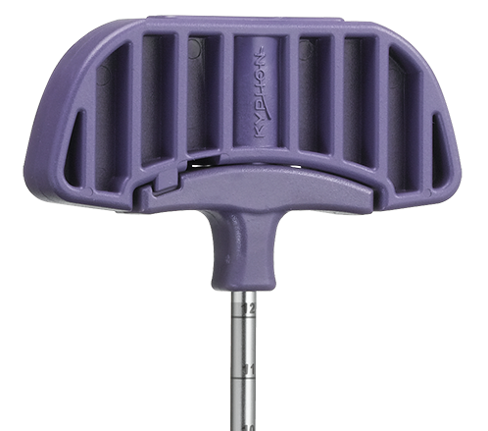
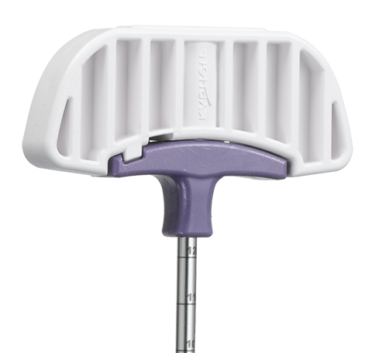
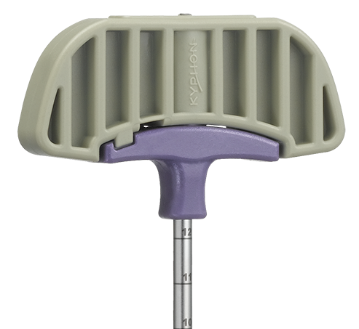



Access
Kyphon One- step™ Osteo Introducer ™ System
Handle colors correspond to tip shape
  Purple – Diamond (4 sided)
  White – Traditional Trocar (3 sided)
  Beige/Taupe – Traditional Bevel (Scoop)

Slide 7
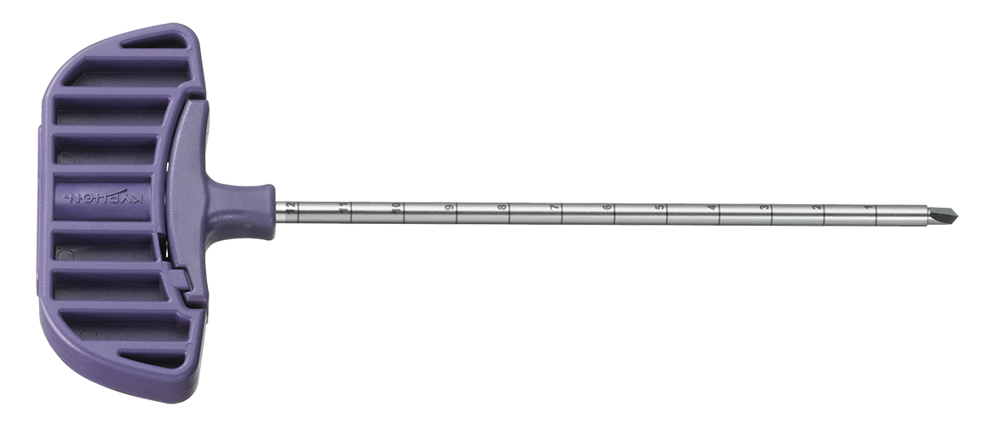
Access
markings
Markings
  Access instruments are marked with 1 cm markings

Slide 8
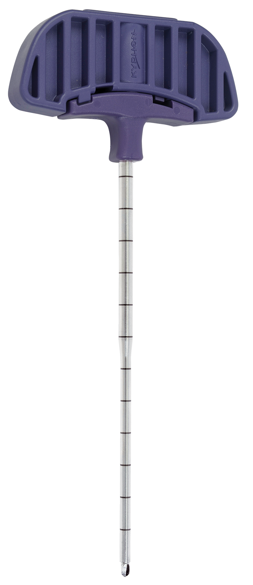
access
System sizes
Size 3
Size 2 (Kyphon Express™)
There are 2 different size options
Size 3
  8 gauge system
  4.2mm outer diameter of instruments
Size 2 (Also known as Express)
  10 gauge system
  3.4mm outer diameter of instruments
Physician preference and location in spine dictate which size is used
**Size 3 and Size 2 (Express) instruments cannot be used interchangeably
7 gauge
Proximal
8 gauge
Tapers to 10 gauge

Slide 9
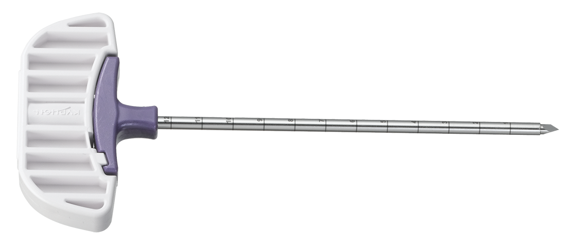
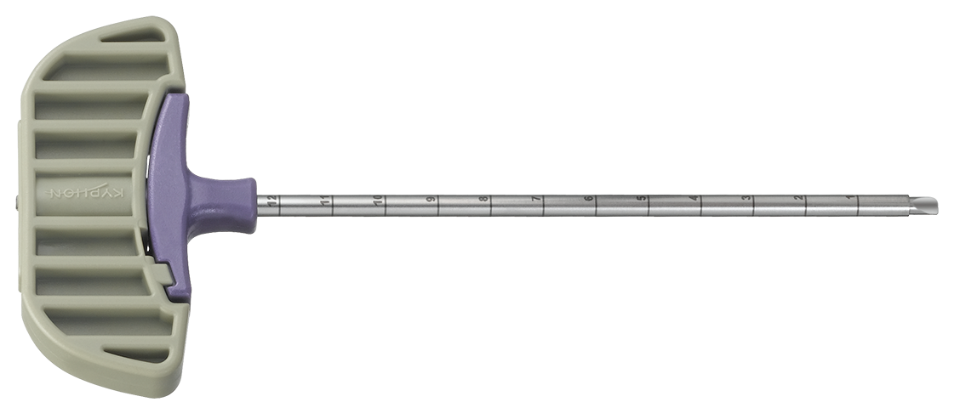

Access
Instrument Specifications
Handle color
Tip
Use
Size 2 (Express)
Size 3
White
Trocar 3-sided
Accessing harder bone and getting good purchase in bone
Provided a la carte only
Included in kits
Purple
Diamond 4-sided
Versatile and easily steerable
Included in kits
Included in kits
Beige/Taupe
Bevel Scoop-bevel
Redirect via arrow on handle
Included in kits
Provided a la carte only

Slide 10
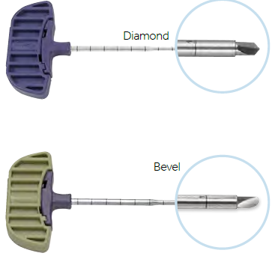
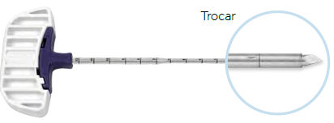
Access
KYPHON EXPRESS™ OSTEO INTRODUCER™ SYSTEM
A la Carte Option
Notes:
Additionally, know the locking switch and what is locked and what is not. This is an area that can be frustrating for a physician and staff and cause distractions and delays during the procedure.

Slide 11
Channel creation biopsy/drill

Slide 12
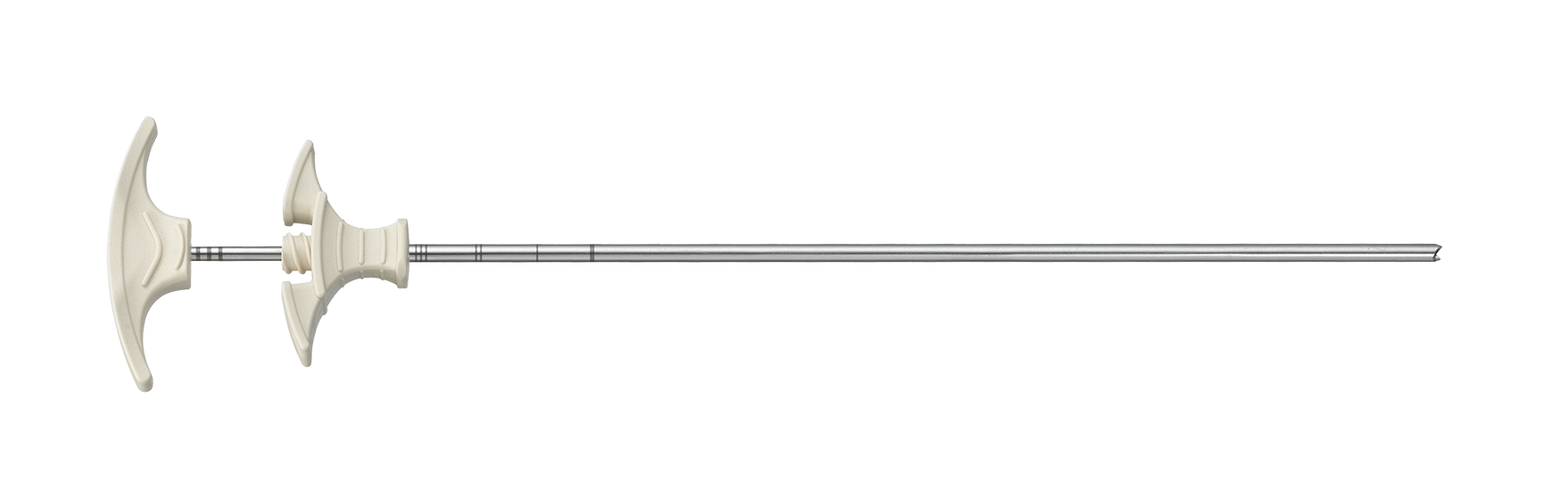
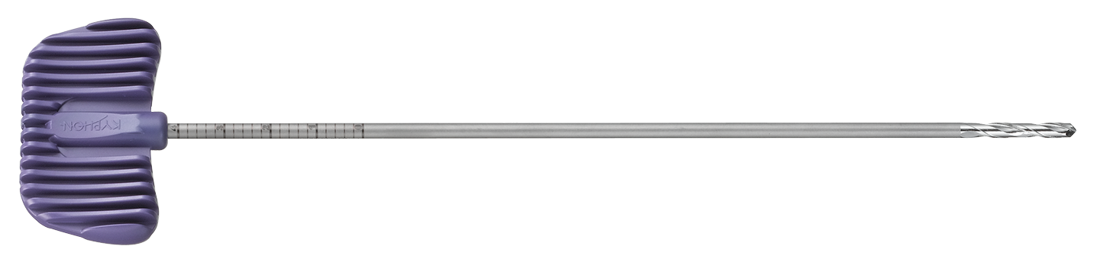
Channel creation
options
Use the Bone Biopsy Device or Precision Drill to create a channel for the balloon
Bone Biopsy Device (a la carte option)
Precision Drill

Slide 13
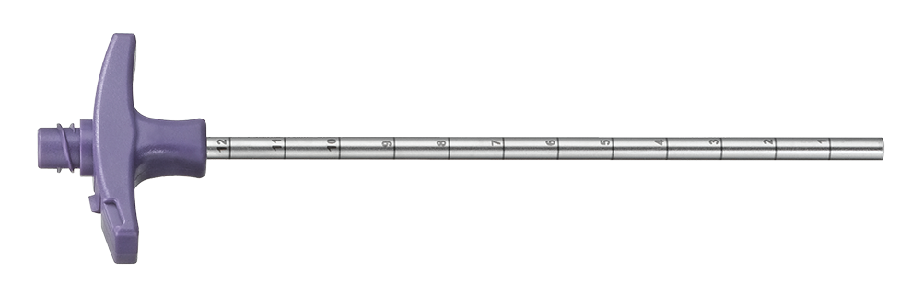
Channel creation
Instrument markings
Instruments used after initial access have consistent markings
  Distal line indicates that the distal end of the instrument is flush with the distal tip of the cannula.
  1cm markings proximal

Slide 14
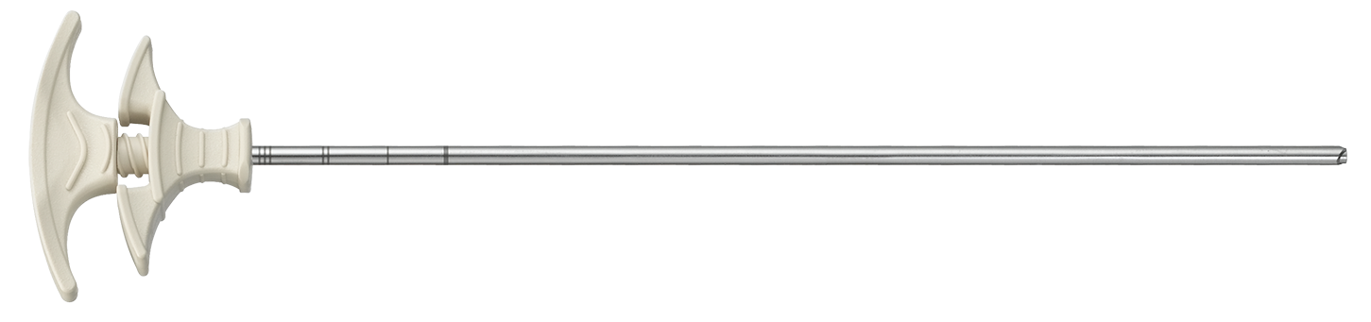
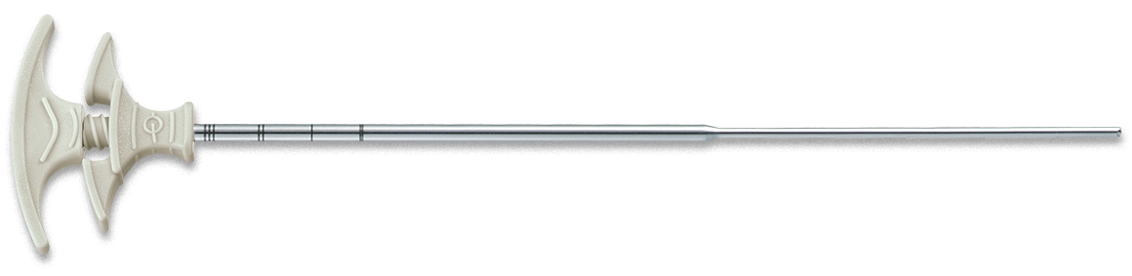
Channel creation
Bone biopsy device (BBD) A la carte
Use to obtain a core sample of bone
  Sharp, Concave Cutting tip
  No mallet required
  Not included in KyphoPak Tray
  Sold a la carte or in a 10 pack

Slide 15
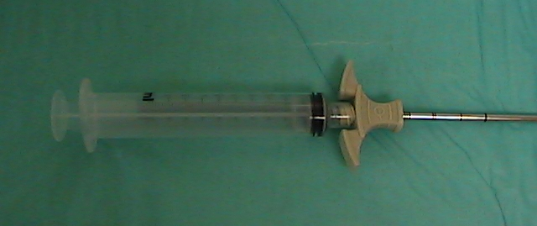
Channel creation
Bone biopsy device (BBD) A la carte
Syringe may be used to aspirate the sample
Vacuum can also be created by capping with a finger
Notes:
Read slide

Slide 16
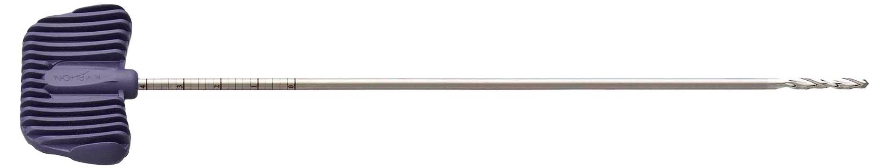
Channel creation
Kyphon™ precision drill
Creates channel for IBT
Rotate clockwise to advance
Continue to rotate clockwise when removing in order to create smoother channel
Markings:
  1st mark (most distal)- flush with distal end of working cannula
  Thick marks – every 1 cm
  Thin marks – every 2 mm

Slide 17
Cavity creation

Slide 18
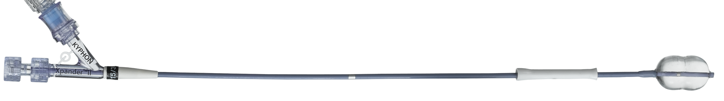
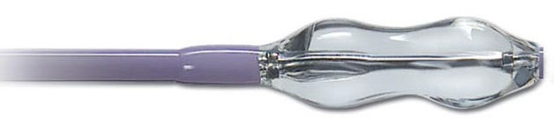
Cavity Creation/ Fracture Reduction
IBT Diagram
Silver exit marker Indicates when IBT is flush with the distal end of the cannula
Inflation Port
Balloon
Sleeve
Stylet
Exit Marker
Radiopaque Markers
Stylet Port

Slide 19
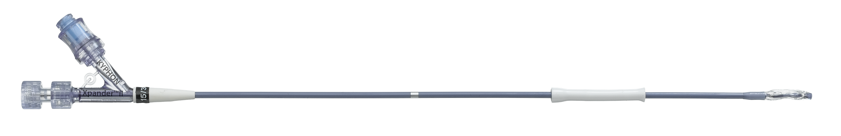
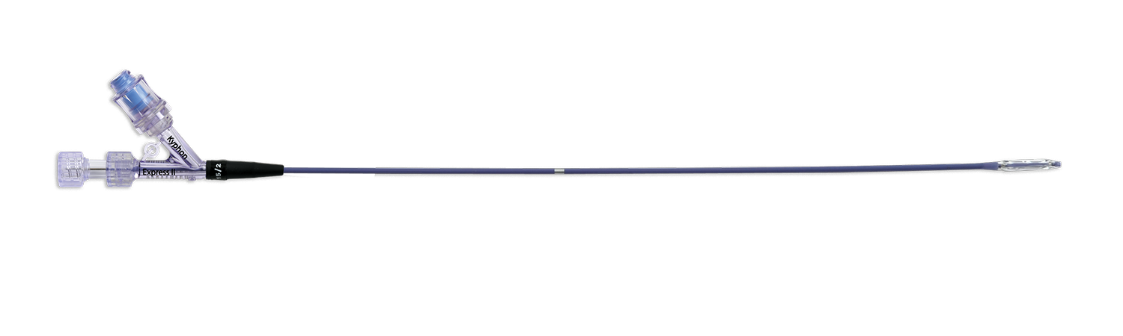
Cavity Creation/ Fracture Reduction
Color markings
Wide color bands indicate system size
  White – Size 3 (Xpander)
  Black Size 2 (Express)

Slide 20
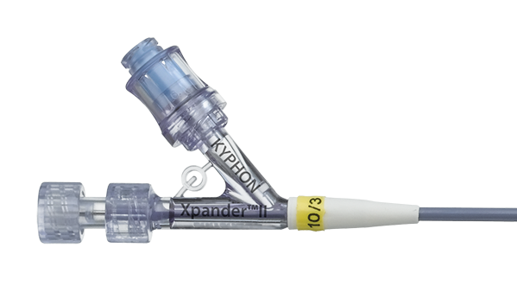
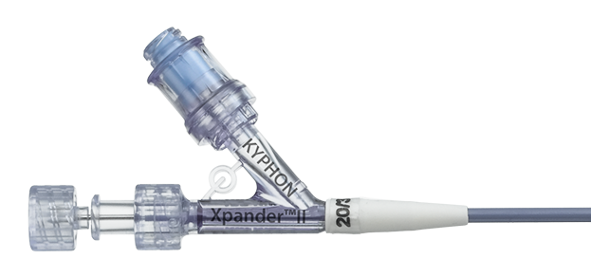
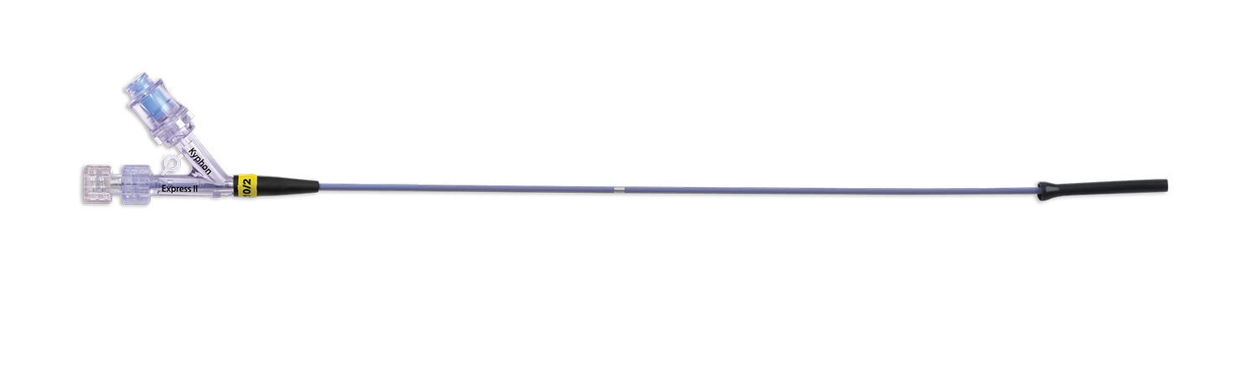
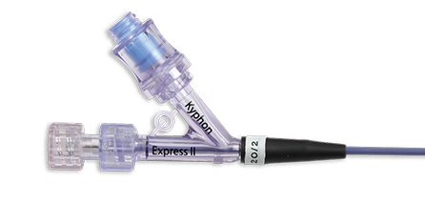
Cavity Creation/ Fracture Reduction
Color markings
Narrow color markers bands on balloon band indicate balloon length
  Yellow – 10mm
  Black – 15mm
  White – 20mm
10/3
15/3
20/3

Slide 21
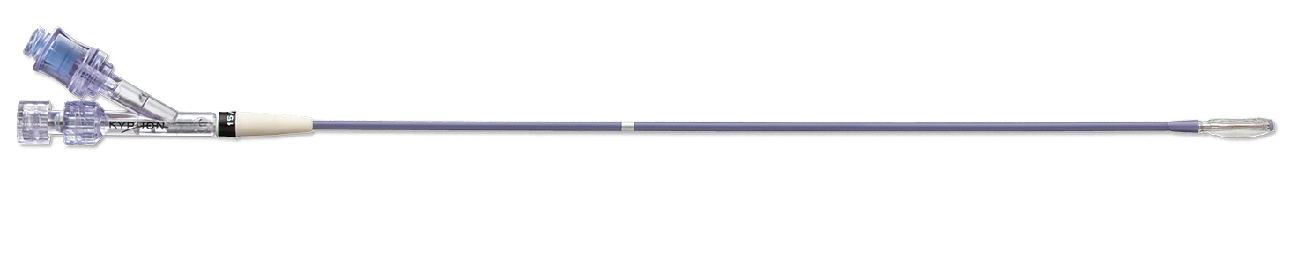
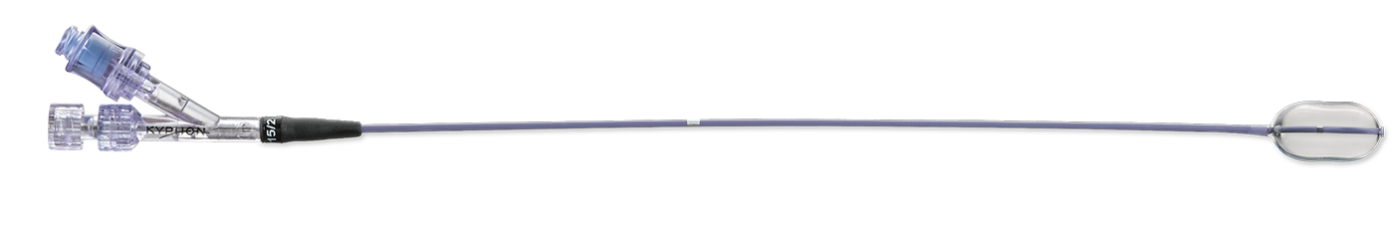
Cavity Creation/ Fracture Reduction
Kyphon express™/Kyphon expander™ vs. Kyphon express™ II/Kyphon expander™ II
Swoosh on Kyphon Expander™ II and Express™ II – only visible difference

Slide 22
Cavity Creation/ Fracture Reduction
Volume and pressure comparison
Size | Xpander™ | Xpander™ II
10/3 | 4cc, 400 psi | 4cc, 700 psi
15/3 | 4cc, 400 psi | 5cc, 700 psi
20/3 | 6cc, 400 psi | 6cc, 700 psi
Size | Express™ | Express™ II
10/2 | 4cc, 400 psi | 3cc, 700 psi
15/2 | 5cc, 400 psi | 4cc, 700 psi
20/2 | Not available | 5cc, 700 psi

Slide 23
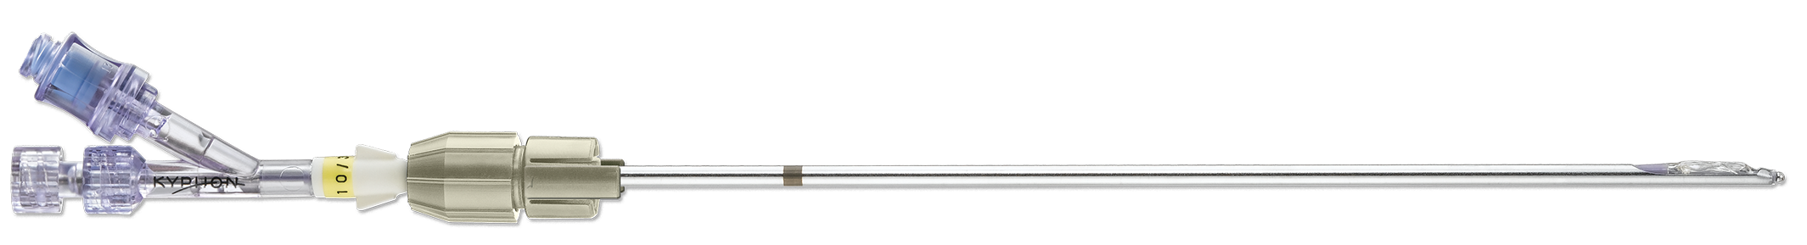
Cavity Creation/ Fracture Reduction
KYPHON Exact™ Inflatable Bone Tamp (IBT)
Unidirectional IBT
Focused fracture reduction and to reduce unintended contact with lateral walls
Sold a la carte only
Available in Size 3 only

Slide 24
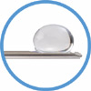
Cavity creation/fracture reduction
KYPHON Exact™ Inflatable Bone Tamp (IBT)
Features:
  Stainless steel, rigid shaft
    1.5” shorter than Xpander™
    Stylet cannot be removed
  Inflates through a window on the shaft and toward slanted portion of Y-hub
  Directional guide helps hold IBT in directed position
Sizes
  10/3, 3 cc, 300 psi
  15/3, 4 cc, 300 psi
Inflation direction
Notes:
Unidirectional-exact (shorter name) 10/3 and 15/3
It’s still a balloon and will go to the path of least resistance, watch under fluoro
Stainless Steel shaft
Tends to protect on direction or focused area
But will inflate in other directions
Use in Narrow VB
Compared with currette
-curette $215
-Balloon $1425
Balloons not as successful a “bailout”
Size 3 only, , focus on currette, not balloons,
Know the pressure and volume as they are test questions

Slide 25
Cavity creation/fracture reduction
KYPHON Exact™ Inflatable Bone Tamp (IBT)
Target customers
  All trained physicians
Application
  Review films pre-operatively or
  correct trajectory (“bail out”)
  Remove sleeve
  Insert into cannula after IBT channel has been created
  Orient IBT in preferred direction and tighten directional guide onto cannula
  Hold IBT shaft as inflating
  Check under fluoro to ensure not rotating during inflation

Slide 26
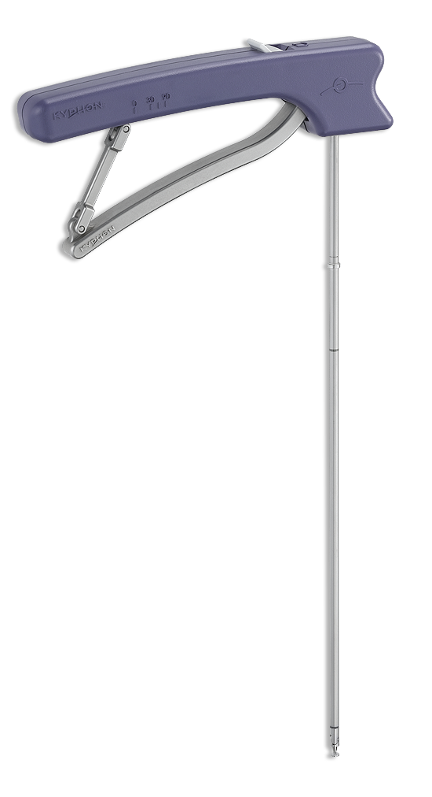
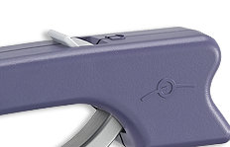
Cavity creation/fracture reduction
KYPHON Latitude II™ Curette
Scrape and score sclerotic and partially-healed bone
  Maximizes effectiveness of IBT
  Tip articulates 0-90° towards short end of handle
  Locks in 30 ° increments
  Available in Size 3 only
Notes:
Tip articulates toward the short end of handle
Position appropriately
Rachet Phase
A/P scraping
Little bit of windshield or rotational
180 to 90 degrees depending on placement
Checking in live, or pulse
Protect lateral walls and endplates

Slide 27
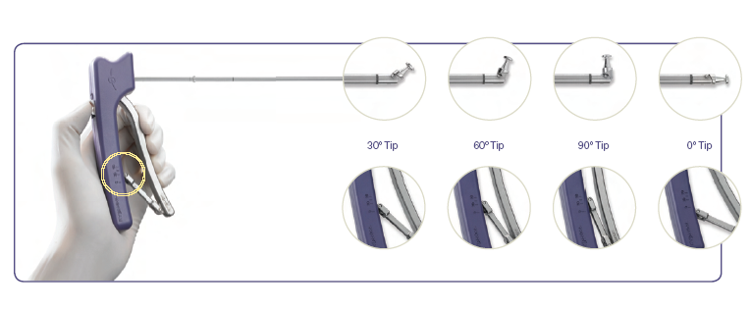
Cavity creation/fracture reduction
  KYPHON Latitude II™ Curette
  Squeeze handle for free movement OR
  Ratchet and lock in 30° increments
Notes:
Discuss from the slide and demonstrate.

Slide 28
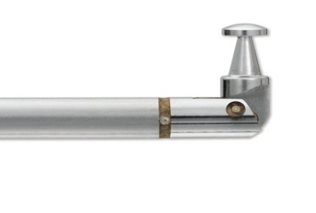
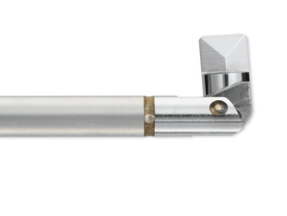
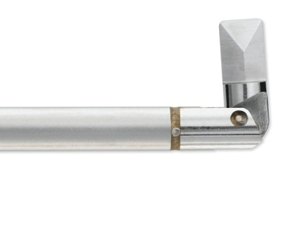
Cavity creation/fracture reduction
KYPHON Latitude II™ Curette
Conical tip
Sold a la carte and in pack of 5
Preferred use:
  Close to endplates
  Rotational (medial/lateral) directions
Straight, low-profile tip
Both sizes sold a la carte and 5-pack
Preferred use:
  when little or no initial cavity has been created
  translational (A-P) direction
8.0 mm T-tip
6.5 mm Wedge-tip
8.5 mm Wedge-tip
Notes:
Teach how to use outside of patient
Mushroom or conical tip
Sold a la carte or in packs of 5
One size 8mm in length
Scraping and scoring near endplates because of round tip, won’t go through endplates as easy
And for rotational or medial/lateral directions
No cutting edges
One size
MD preference for use near endplates

Slide 29
Cavity creation/fracture reduction
KYPHON Latitude II™ Curette
Straight, low-profile tip
Both sizes sold a la carte and 5-pack
Preferred use:
  when little or no initial cavity has been created
  translational (A-P) direction
6.5 mm Wedge-tip
8.5 mm Wedge-tip
Notes:
Be sure to explain the A-P direction talks about how the tool is moved, not how the handle is oriented.
Straight, low profile tip, thin, slim, easy to articulate
Hard sclerotic bone/old fx
Curette before balloon??
6.5 or 8.5 mm sizes, extends beyond the shaft
A/P function first then rotate
Not a lot of resistance
Make A/P grooves then do rotational motion to break up the bone in between

Slide 30
Cavity creation fracture reduction
KYPHON Latitude II™ Curette
Safety features
  Exit marker
  Stop collar prevents tip from extending more than 3.7 cm past cannula
  Dual tip attachment mechanism
  Scored shaft
Exit marker
Stop collar
Notes:
Exit Marker, distal end of cannula
Stop collar-prevents anterior wall puncture, but not always
Hold onto cannula when using to prevent cannula from moving anterior
3. Laser Scored shaft-proximal to the stop collar, enough torque applied or rotational pressure it will break at the score to prevent going through cortical wall. Breaks @ score, tip will go limp, loss of resistance, confirm with fluoro, remove immediately, don’t continue to manipulate or it may become stuck.

Slide 31
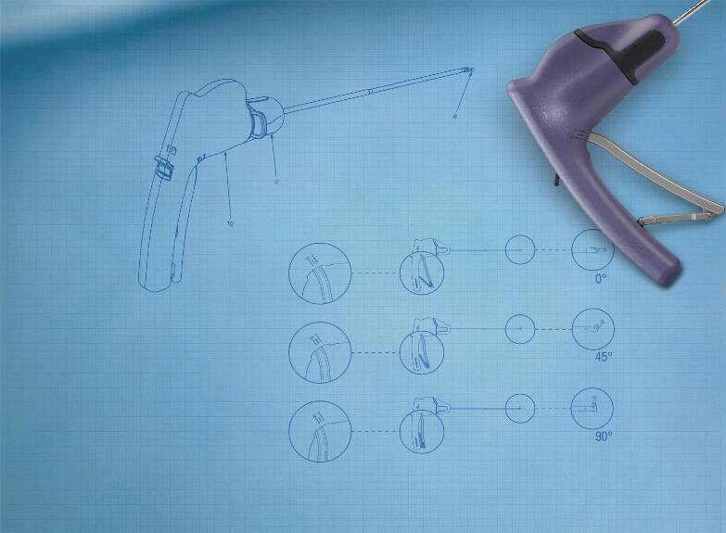
Cavity creation/fracture reduction
Kyphon Express™ Curette
Target Segment
  Using the curette either before or after balloon inflation may result in larger balloon volumes > increased lift forces
  New Integrated Torque Reset Mechanism (TRM Technology) > curette may last entire case
  List Price $545 each / $2340 for 5 –Pack
Notes:
The curette has advantages and applications in nearly all of the VCF we treat.
It can be used to assist with scraping and scoring sclorotic bone.
It can be use to assist in directing an IBT away from a breeched wall or end plate.
It can direct a physician away from an end plate or wall if the trajectory or approach was not optimal.
This is a tool that can assit a surgeon in achieving maximum inflation and potentially height restoration.

Slide 32

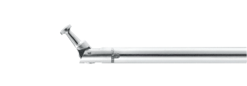
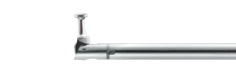
Cavity creation/fracture reduction
Kyphon Express™ Curette T-tip
Premium curette
ONLY product that can be used with Size 2 (Express™) and Size 3 instrumentation
Integrated torque reset mechanism (TRM)
  Easily reset device when tip encounters excess torsion to minimize breakage and maximize procedure efficiency
Express tools compatibility
  Lower profile (10 gauge) for usage with Kyphon Express Size 2 Access Tools
More robust tip design
  Achieved through extensive finite element analysis
T-Tip configuration (7.0 mm)
0°
45°
90°
Notes:
Size 2 curette will fit down a Size 3 cannula.
Only comes in the T-tip
Reset mechanism that allows the device to disengage and be reset 4 times, we will discuss this more in the upcoming slides.

Slide 33
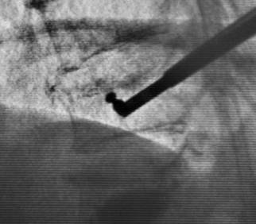
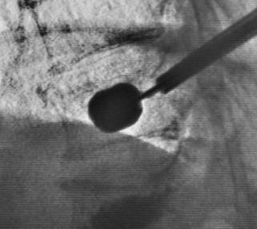
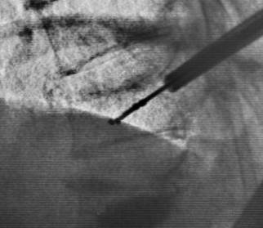
Cavity creation and fracture reduction
Curette Usage & Technique
Curette before IBT
When to use the curette
Initial inflation has undesirable or asymmetric shape
  Initial inflation is too lateral or inferior
  Balloon barely inflates or does not inflate
User wants pre-determined inflation pathway
Remember: Both “Scrape & Score”
  T-Tip – near endplates, rotational directions
  Wedge – pre-determined path, AP directions
Insert IBT
Controlled inflation
Images courtesy of Dr. Richard Levenberg (Drexel Hill, PA)

Slide 34
injection

Slide 35
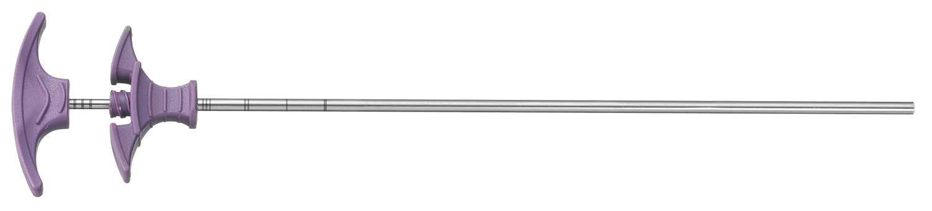
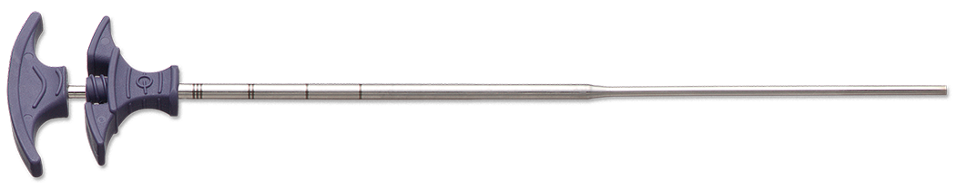
injection
kyphon™ Bone Filler Device (BFD) and Express™ Bone Filler Device
Available in Size 2 (Express™) and Size 3
BFD cannula markings
  1st mark (most distal)– flush with distal end of working cannula
  Additional marks every 1 cm

Slide 36
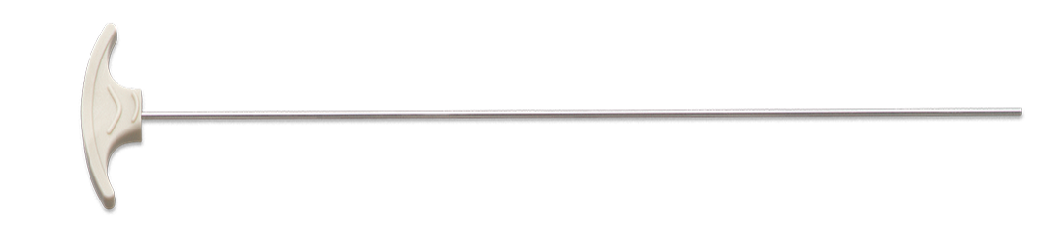
injection
Bone Filler Devices
 | Capacity (ea.) | Quantity in kit | Amount in System
Size 2 (Express™) | 1cc 1.2cc with long plunger | 8 | 8cc 9.6cc
Size 3 | 1.5cc | 6 | 9cc

Slide 37

injection
Bone Filler Device
Use plunger to dispense bone cement out of BFD cannula
  Plunger marks indicate .5 cc of bone cement increments
Marks
Notes:
Important note about stylet markings, they give you a working knowledge of how many cc’s of cement have been delivered. One word of caution, if you use the BFD to test the consistence of the cement, note how much has been used so you have an estimate of how many cc’s have been delivered.
If a stylet is dropped during the procedure, the BBD stylet can be used to push out the cement if necessary, or remove a stylet that has been used, wipe off the cement residue and use.

Slide 38




injection
kyphon™ Cement Delivery System

Slide 39
injection
kyphon™ Cement Delivery System
Features | Benefits
48” Tubing | Reduced Radiation
One-handed Operation | Comfortable, easy to use
0.2 cc of cement per squeeze | Precise control
Quick Release Button halts cement instantly | Precise control
2 - 8cc Cartridges, compatible with current mixer | Easy to integrate into current practice, minimal learning curve

Slide 40


kyphon™ Directional bone filler device
BFD with side opening
  Enables cement placement in physician’s intended direction
  Available in size 2 and 3
  Sold a la carte only
Notes:
Similar to BBD
Look at arrow on top
Size 2 and 3
A la carte (138.00)
Oval opening, 4mm or 7mm, length of oval
Selling situations

Slide 41

kyphon™ Directional bone filler device
Selling Situations
  Direct cement away from a weak or breached endplate
  Steer cement toward under-filled area
Application
  Do not leave partially- dispensed DBFD setting up in patient as it may become locked into the vertebral body
Notes:
Breached wall, weak endplate to avoid fractured area
Use with really thick cement
Larger opening, can steer cement as you fill
Do not leave in VB; insert the cement and then remove immediately.
Don’t ever leave in cannula, can be cemented in

Slide 42
recap
Access and Balloons
 | Size 3 | Size 2 (Express)
Introducers | Kyphon One- Step™ Osteo Introducer™ System Kyphon™ Osteo Introducer™ System Kyphon™ Advanced Osteo Introducer™ System | Express™ System Express™ Advanced OsteoIntroducer System
Inflatable Bone Tamps (Balloons) | Xpander™ IBT Xpander II™ IBT | Express™ IBT Express II™ IBT

Slide 43
Products Provided in Size 2 and/or Size 3
Product | Size 2 | Size 3 | Notes
Xpander™ IBT/Xpander II™ IBT |  | X
Express™ IBT/Express II™ IBT | X
Exact™ IBT |  | X
Latitude II™ Curette |  | X
Express™ Curette | X | X | ONLY instrument that can be used in both Sizes
Kyphon™ Cement Delivery Gun and BF | X | X
Bone Filler | X | X
Directional BF | X | X
KYPHON™ Bone Biopsy Device | X | X

Slide 44
Reference
Kit options

Slide 45


First fracture kits
Kyphon One- Step™ Osteo Introducer™ System
Kyphon One- Step™ Osteo Introducer™ System Purple Diamond Tip Introducer (1) White Trocar Tip Introducer (1) | Precision Drill (1) | Xpander™ IBT (2) 10/3, 15/3, 20/3 Merit syringes (2) Locking Syringe (2) | Bone Filler Device (6) Or CDS (1 gun, 2 cartridges, 2 BFDs)
 |  | Xpander™ II IBT (2) 10/3, 15/3, 20/3 Kyphon Inflation Syringes (2) Locking Syringe (1) | Bone Filler Device (6) Or CDS (1 gun, 2 cartridges, 2 BFDs)

Slide 46


First fracture kits
Kyphon™ Osteo Introducer™ System
Kyphon™ Advanced Osteo Introducer™ System Jamshidi needles (2) Guide pins (4 -2 sharp and 2 blunt) Purple OsteoIntroducer with Cannula (1) Additional Cannula (1) | Precision Drill (1) | Xpander™ IBT (2) 10/3, 15/3, 20/3 Merit syringes (2) Locking Syringe (2) | Bone Filler Device (6) Or CDS (1 gun, 2 cartridges, 2 BFDs)
 |  | Xpander™ II IBT (2) 10/3, 15/3, 20/3 Kyphon Inflation Syringes (2) Locking Syringe (1) | Bone Filler Device (6) Or CDS (1 gun, 2 cartridges, 2 BFDs)

Slide 47

First Fracture kits
Kyphon™ Advanced Osteo Introducer™ System
Kyphon™ Advanced Osteo Introducer™ System Jamshidi needles (2) Guide pins (4 -2 sharp and 2 blunt) Taupe Advanced OsteoIntroducer with Cannula (1) Additional Cannula (1) | Precision Drill (1) | Xpander™ IBT (2) 10/3, 15/3, 20/3 Merit syringes (2) Locking Syringe (2) | Bone Filler Device (6) Or CDS (1 gun, 2 cartridges, 2 BFDs)
 |  | Xpander™ II IBT (2) 10/3, 15/3, 20/3 Kyphon Inflation Syringes (2) Locking Syringe (1) | Bone Filler Device (6) Or CDS (1 gun, 2 cartridges, 2 BFDs)

Slide 48




First fracture kits
Express™ system
Express™ Introducer System Purple Diamond Tip Introducer (1) Taupe Bevel Tip Introducer (1) | Precision Drill (1) | Express™ IBT (2) 10/2, 15/2 Merit syringes (2) Locking Syringe (2) | Bone Filler Device (8) w/2 long plungers Or CDS (1 gun, 2 cartridges, 2 BFDs, 2 long plungers)
 |  | Express™ II IBT (2) 10/2, 15/2, 20/2 Kyphon Inflation Syringes (2) Locking Syringe (1) | Bone Filler Device (8) w/2 long plungers Or CDS (1 gun, 2 cartridges, 2 BFDs, 2 long plungers)

Slide 49

Additional Fracture kits
Size 3
2 working cannulas | Xpander™ IBT (2) 10/3, 15/3, 20/3 OR Xpander™ II IBT (2) 10/3, 15/3, 20/3 | Bone Filler Device (6)
You will re-use
  Stylets
  Precision Drill
  Inflation Syringes
  Locking Syringes

Slide 50
Additional Fracture kits
Size 2 (Express™)
2 working cannulas | Express™ IBT (2) 10/2, 15/2 OR Express™ II IBT (2) 10/3, 15/3, 20/3 | Bone Filler Device (8) and 2 long plungers
You will re-use
  Stylets
  Precision Drill
  Inflation Syringes
  Locking syringes

Slide 51

Express II and Express: size 2
Comparison
Product | IBT Size | Initial Length | Max Volume | Max Pressure | Introducer Size | Strength
Express II | 10/2 15/2 20/2 | 10 mm 15 mm 20 mm | 3 cc 4 cc 5 cc | 700 psi | 10 gauge 3.7 mm | Stronger Less Compliant
Express | 10/2 15/2 | 10/3 15/3 20/3 | 4 cc 5 cc | 400 psi | 10 gauge 3.7 mm | Weaker (Than II) Less Compliant

Slide 52




Inflatable Bone Tamps
Maximum rated inflation pressure of 700 psi provides greater lift force potential during vertebral body fracture reduction
Dimensions
Kyphon Express™ II Inflatable Bone Tamp
Kyphon XPANDERTM II Inflatable Bone Tamp
Notes:
Updated tables - from approved PMD0117292-2.0 Kyphon Product Catalog

Slide 53






Other Inflatable Bone Tamps (IBT)
Kyphon XPANDER ™ IBT
Small initial profile, but expand to needed volume.
Shape changes from peanut
to cylinder to distribute force
evenly across endplate.
Radiopaque markers to
visualize initial placement.
Inflated with liquid contrast medium.
Available in omni-directional and uni-directional inflation patterns.
Kyphon Express™ IBT
Kyphon Exact™ IBT
Notes:
Updated tables/added Exact - from approved PMD0117292-2.0 Kyphon Product Catalog

Slide 54
OsteoIntroducer Access
Advanced Osteointroducer access

Slide 55
OVERVIEW
3 TYPES OF SIZE 3 BONE ACCESS SYSTEMS
Kyphon One- step™ Osteo Introducer ™ System
Blunt tip Kyphon™
Osteo Introducer™ System
w/ jamshidi
Kyphon™ Advanced
Osteo Introducer™ System w/ jamshidi
Bevel Tip
Ala Carte Options
Notes:
Additionally, know the locking switch and what is locked and what is not. This is an area that can be frustrating for a physician and staff and cause distractions and delays during the procedure.

Slide 56
Kyphon™ Osteo Introducer™ System
Blunt tip Kyphon™ Osteo Introducer™ System w/ jamshidi

Slide 57


11-gauge Bone Access Needle
Jamshidi
Use to gain initial bone access into VB
Locking/unlocking switch
Diamond Tip
Notes:
Additionally, know the locking switch and what is locked and what is not. This is an area that can be frustrating for a physician and staff and cause distractions and delays during the procedure.

Slide 58

11-gauge Bone Access Needle
JAMSHIDI
Use to gain initial bone access into VB
Stylet
Cannula
# in KyphoPak tray: 2
Notes:
Kyphon has several types of tool kits. We will address all of them during your time in training and you will exposure and hands on application in the lab. We will concentrate your training on the tool kit that incorporates the jamshidi as the initial access device.
It’s size is a 11g
It separates into to parts the stylet and the cannula

Slide 59






3 Types of Ala Carte
KYPHON™ 11GA BONE ACCESS NEEDLES
Twist-off Handle
Diamond
Tip
Trocar
Tip
Bevel
Tip
Notes:
There are also 3 a la carte Standard size 11-gauge bone access needles. Each has a different type of tip and can be used to gain purchase of the bone.
Green Handle is the diamond tip (Flexible) – White Handle is the trocar tip (Best for Tough Bone) – Blue Handle is the bevel tip (Easy to redirect)
As you can see, there is also a different type of handle. It twists off instead of having the locking tab.

Slide 60
Guide pins
2 Sharp and 2 blunt
Functions of the Guide Pin:
It’s a bookmark for Tool Exchange to guide the Osteo Introducer into the Vertebral Body
  Remove Jamshidi Stylet
  Insert Guide Pin into cannula of Jamshidi
  Exchange Jamshidi for Osteo Introducer + Working Cannula
2 styles: sharp and blunt

Slide 61
Osteo introducer™ System
Cannulated
Placed over the guide pin to desired position in patient
Once the stylet is removed, the cannula is left in the patient and all remaining steps will be performed through the cannula

Slide 62


Kyphon™ Advanced Osteo introducer™ (AOI)
Fluted, drill-like tip design for controlled access, no mallet required
Potentially eliminates need to drill
Notes:
This is used in conjunction with the jamshidi and guide wire as well.
It potentially eliminates the need for a mallet and a drill (remember to remove the stylet the same way you accessed the VB after unlocking from the hub).
Some physicians like this product for accessing a patient that is under MAC, to reducing the amount of moving while accessing the VB.
The spacer is to the right, which leads us to our next slide…

Slide 63


Kyphon™ Advanced Osteo introducer™ (AOI) & Spacer
Use spacer when a biopsy is desired using the AOI.
+
18mm
+
=
3mm
Notes:
The Spacer is used to preserve the cancellous bone in the vertebral body in order to take a biopsy. Separate the stylet from the cannula and attach the hub of the Spacer to the handle of the stylet. Reassemble the cannula and use to gain access to the vertebral body.

