Slide 1
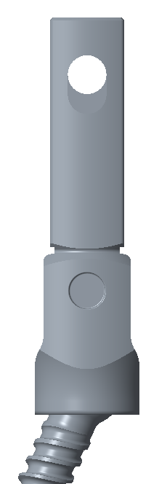
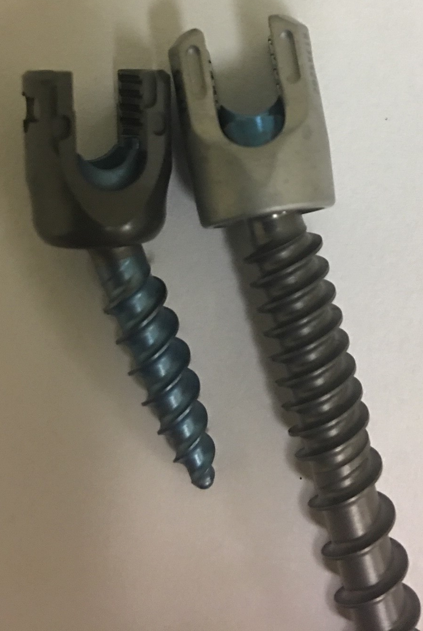
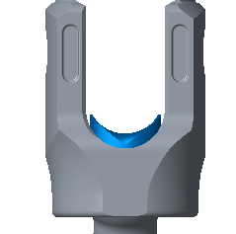
 |  | CD HORIZON® SOLERA® 4.75mm Spinal System | CD HORIZON® SOLERA® 5.5/6.0mm Spinal System | CD HORIZON® SOLERA® Voyager™ 5.5/6.0mm Spinal System | Nuvasive RELINE Small Stature 5.0mm Spinal System
 | Run-on-Rod | 8.2mm | 9.28mm | 9.28mm | 8.8mm
 | Footprint Parallel to the Rod | 10.43mm | 11.1mm | 11.1mm | 10.27mm
 | Footprint Perpendicular to the Rod | 10.43mm | 12.73mm | 11.65mm | 10.95mm
 | Overall Height | 14.8mm | 17.04mm | 17.04mm | 12.95mm

